Slide 1
multi-state models 23 january 2015
capture recapture
19-23 january 2015
UDEC, Concepción Chile

Slide 2
Cormac-Jolly-Seber as a multi-state
We looked at the CJS model previously as a super-population model
Death
Probability of capture
Can also formulate JS model as a multi-state, which allows us to expand it easily for additional state – e.g., areas or stages

Slide 3
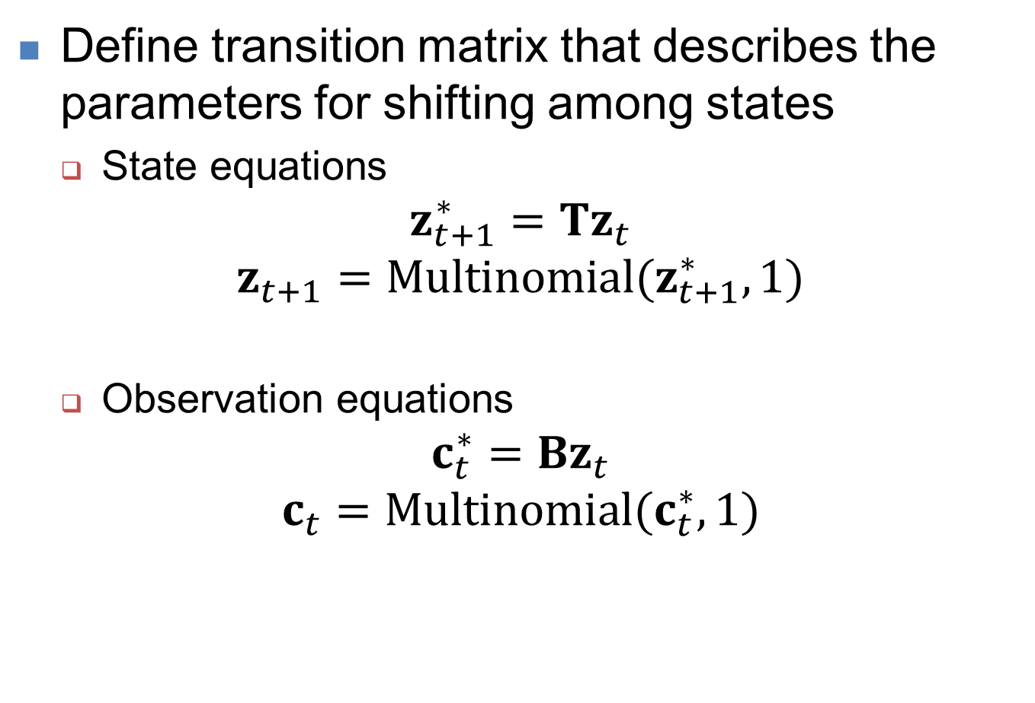
Steps for multi-state model
Define transition matrix that describes the parameters for shifting among states
State equations
$$z_{t+1}^{∗}=Tz_{t}$$
$$z_{t+1}=Multinomial(z_{t+1}^{∗},1)$$
Observation equations
$$c_{t}^{∗}=Bz_{t}$$
$$c_{t}=Multinomial(c_{t}^{∗},1)$$

Slide 4
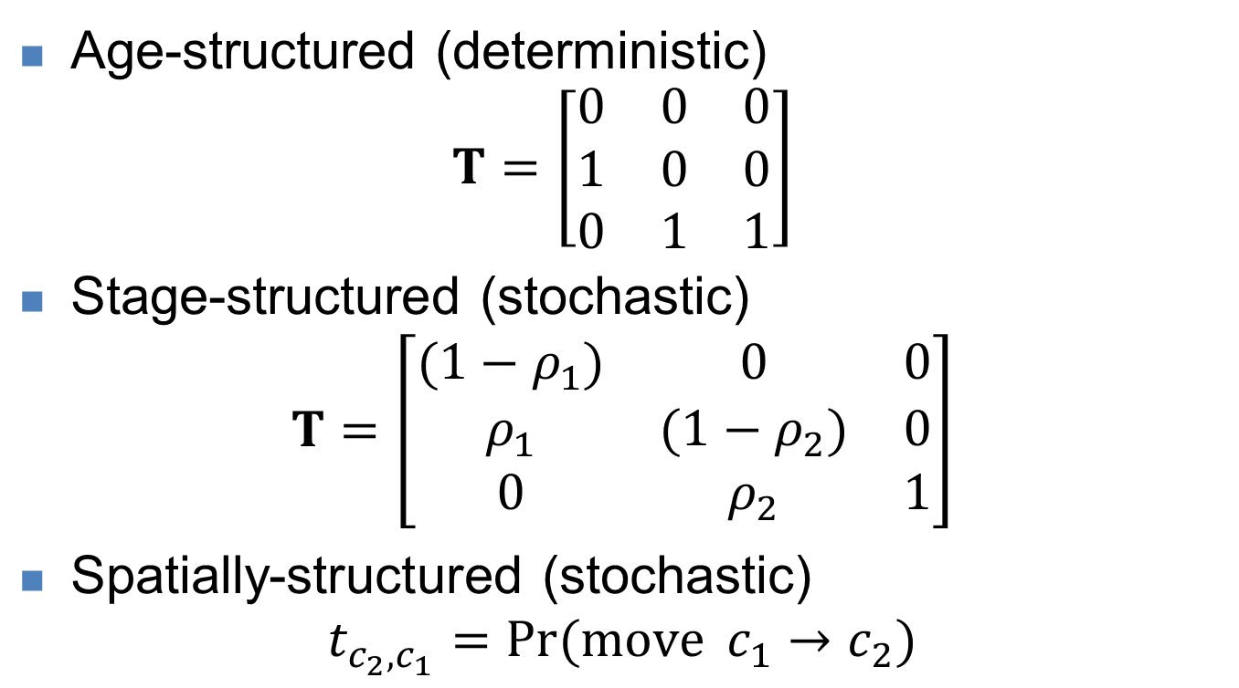
Steps for multi-state model
Age-structured (deterministic)
$$T=\left[\begin{matrix}0 & 0 & 0 \\ 1 & 0 & 0 \\ 0 & 1 & 1\end{matrix}\right]$$
Stage-structured (stochastic)
$$T=\left[\begin{matrix}(1−ρ_{1}) & 0 & 0 \\ ρ_{1} & {(1−ρ}_{2}) & 0 \\ 0 & ρ_{2} & 1\end{matrix}\right]$$
Spatially-structured (stochastic)
$$t_{c_{2},c_{1}}=\operatorname{Pr}{(move }c_{1}→c_{2})$$

Slide 5
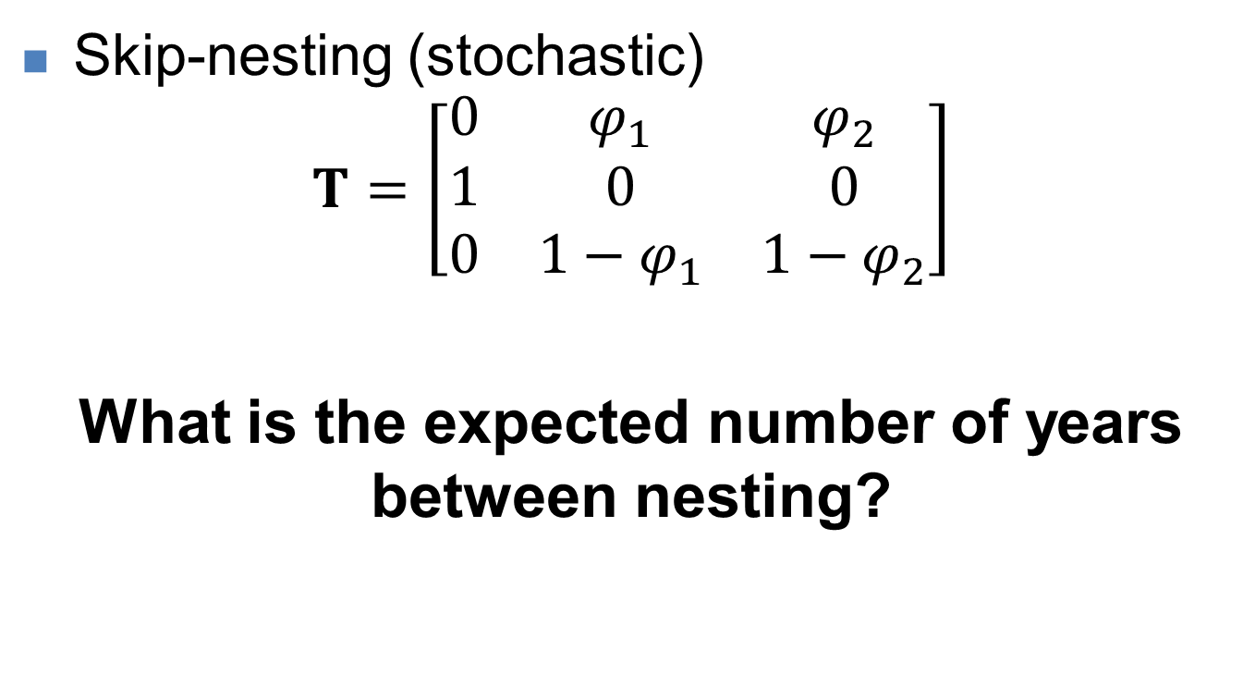
Steps for multi-state model
Skip-nesting (stochastic)
$$T=\left[\begin{matrix}0 & φ_{1} & φ_{2} \\ 1 & 0 & 0 \\ 0 & {1−φ}_{1} & {1−φ}_{2}\end{matrix}\right]$$
What is the expected number of years between nesting?

Slide 6
Steps for multi-state model
Define transition matrix that describes the parameters for shifting among states
State equations
$$z_{t+1}^{∗}=Tz_{t}$$
$$z_{t+1}=Multinomial(z_{t+1}^{∗},1)$$
Observation equations
$$c_{t}^{∗}=Bz_{t}$$
$$c_{t}=Multinomial(c_{t}^{∗},1)$$

Slide 7
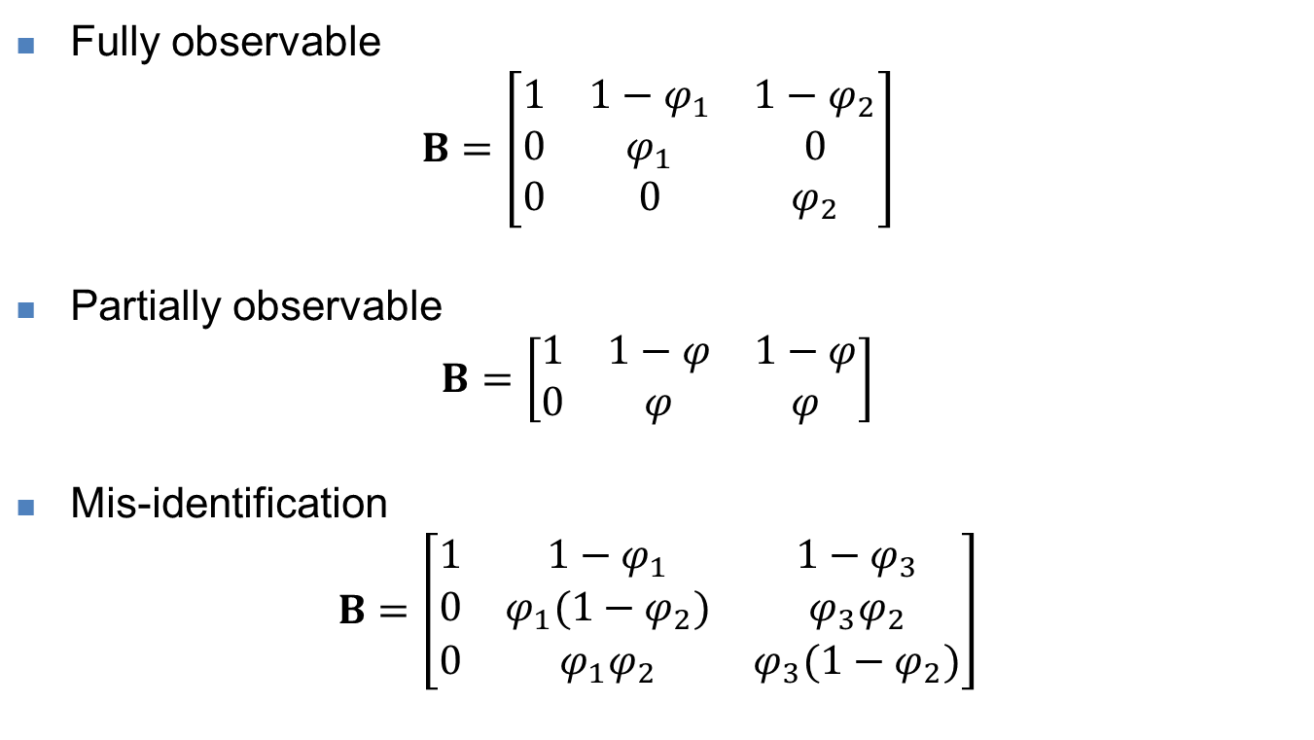
Steps for multi-state model
Fully observable
$$B=\left[\begin{matrix}1 & 1−φ_{1} & 1−φ_{2} \\ 0 & φ_{1} & 0 \\ 0 & 0 & φ_{2}\end{matrix}\right]$$
Partially observable
$$B=\left[\begin{matrix}1 & 1−φ & 1−φ \\ 0 & φ & φ\end{matrix}\right]$$
Mis-identification
$$B=\left[\begin{matrix}1 & 1−φ_{1} & 1−φ_{3} \\ 0 & φ_{1}(1−φ_{2}) & φ_{3}φ_{2} \\ 0 & φ_{1}φ_{2} & φ_{3}(1−φ_{2})\end{matrix}\right]$$

Slide 8
Cormac-Jolly-Seber as a multi-state
Can also be used for occupancy or abundance models
Occupancy:
Succession in vegetation communities
Categories of density, e.g., {zero, low, high}
Abundance
Abundance at size/age/sex

